Slide 1
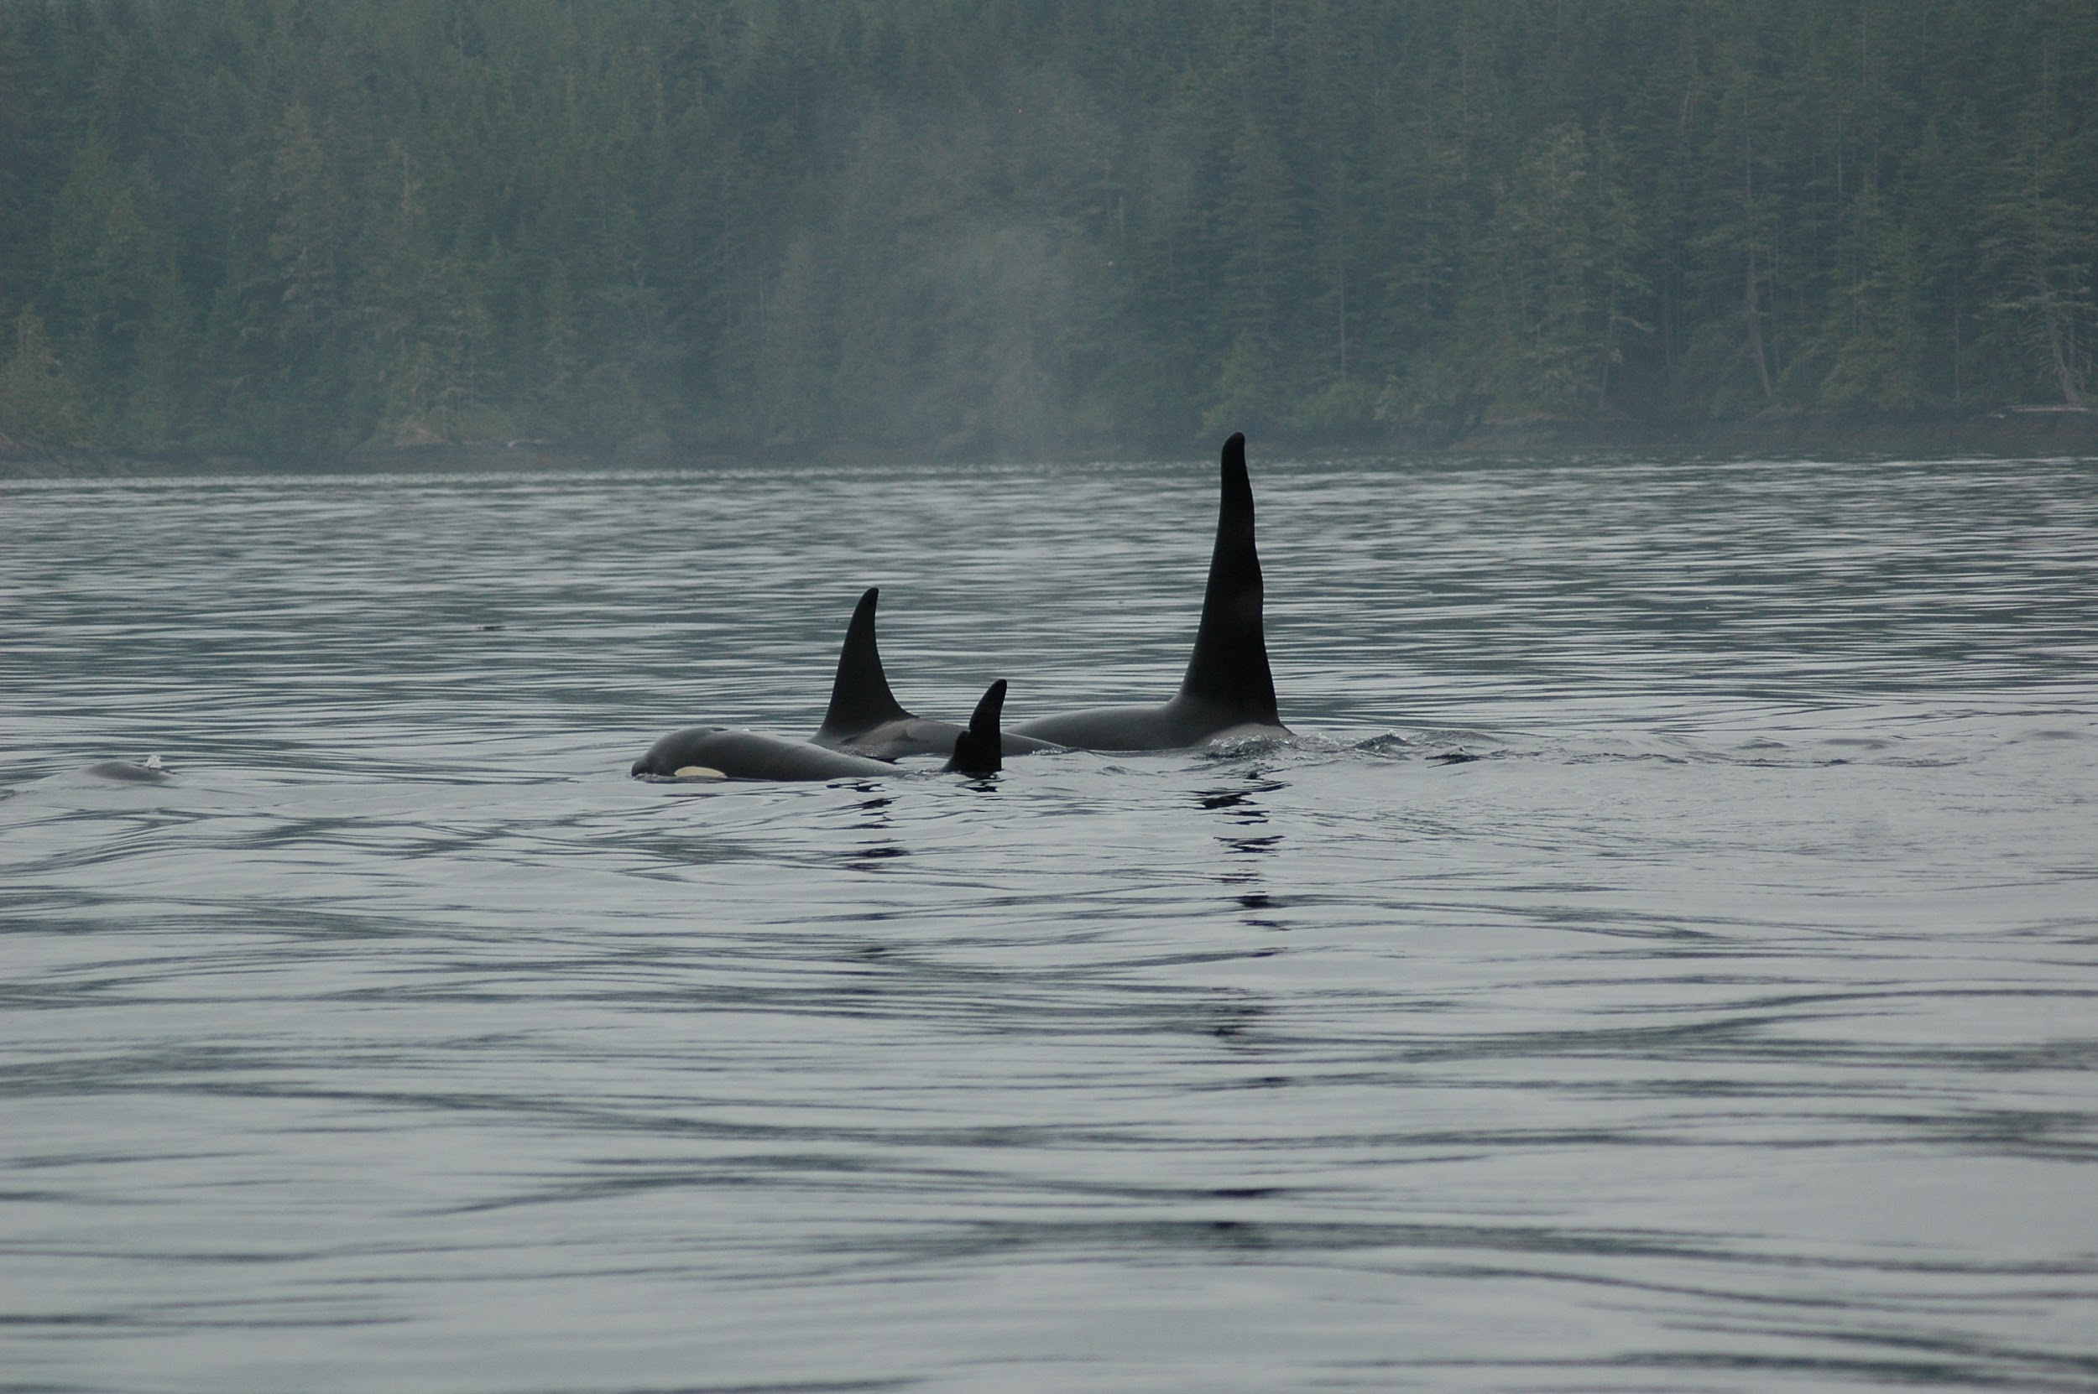
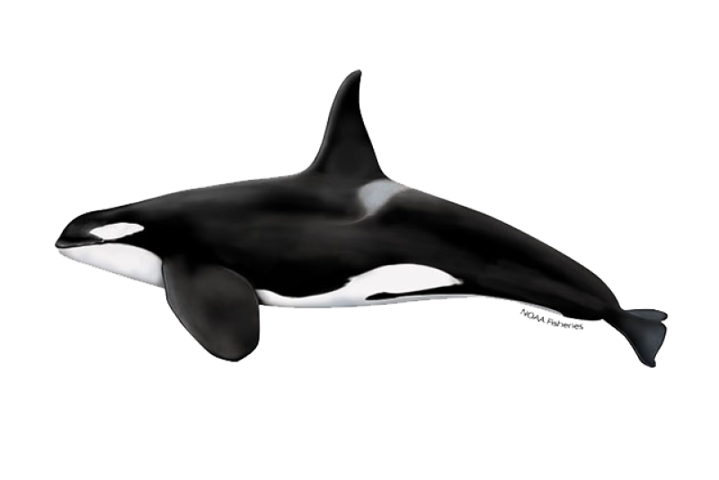
The Impact of Salmon Quantities on Lactating Northern Resident Killer Whales
By: Maddy, Kaylie, Clara, and Penelope
“Family feud: permanent group splitting in a highly philopatric mammal, the killer whale (Orcinus orca)”
by Eva H. Stredulinsky, Chris T. Darimont, Lance Barrett-Lennard, Graeme M. Ellis & , John K. B. Ford

Slide 2
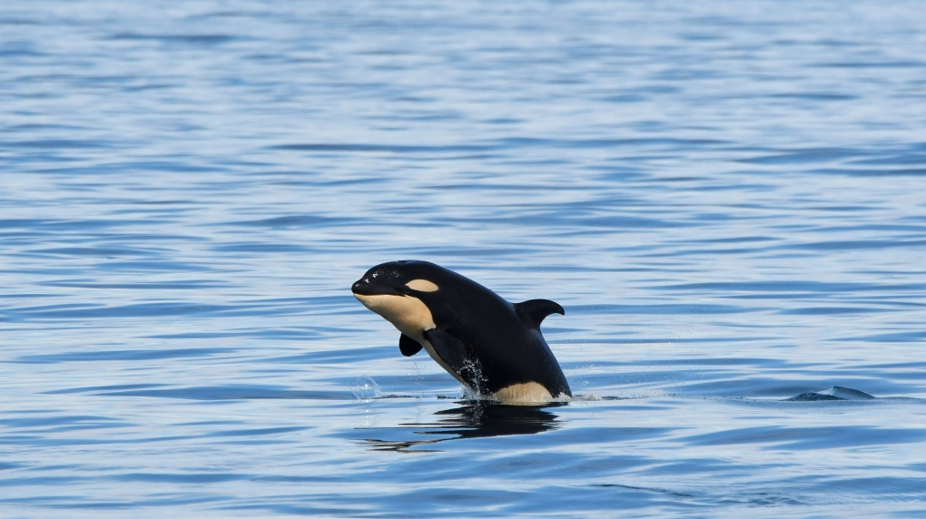
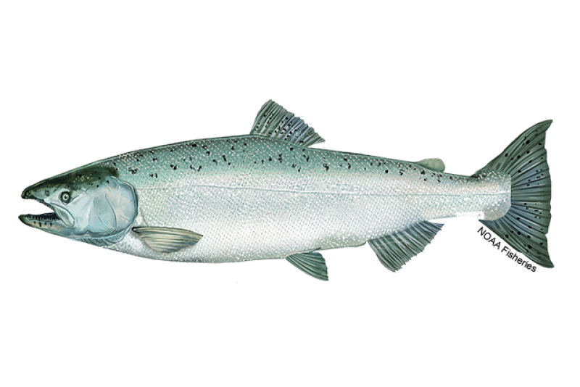
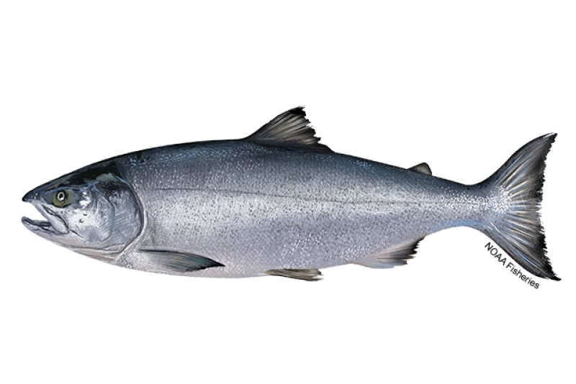
Background
Pods - groups of orcas (matrilines)
Resident northern killer whales - exclusively fish-eating (Chinook and Chum Salmon)
Population socially and genetically isolated
Eastern Coastal Areas of North Pacific
Notes:
Clara:
In “Family feud: permanent group splitting in a highly philopatric mammal, the killer whale (Orcinus orca)” significant factors in determining pod splitting
Pods are groups of orcas all related through their mothers, also called matrilines.
Resident killer whales refers to specific populations of killer whales that are exclusively fish-eating.
This population is also socially and genetically isolated from the other resident killer whales
the eastern coastal areas of the North Pacific ranges: from the eastern coast of Alaska to Washington.

Slide 3
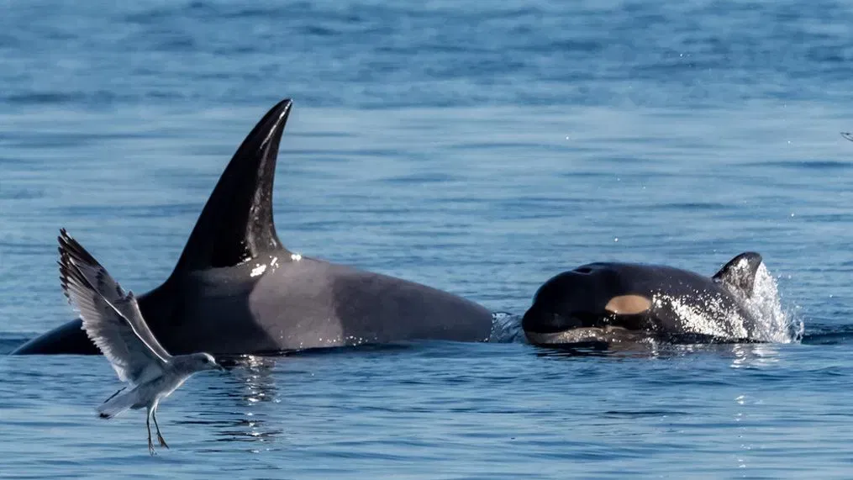
Hypothesis and Predictions
Hypothesis:
Salmon quantities and pod size will influence the number of lactating females in a pod.
Based on predictions:
*Higher numbers of salmon will provide more successful reproduction.
*Larger pod size -> more females
Notes:
Clara:
In our own research, instead of looking at pod spitting we focus:
We hypothesize: Salmon quantities, will influence the number of lactating females in a pod (because it was also part of the data the researchers collected).
Lactating females as a measure of fecundity in the population since lactating females would have had a calf in thelast 2 years
Based on predictions:
*Higher numbers of salmon will provide more resources for orcas and more successful reproduction.
(why do we think this?)

Slide 4
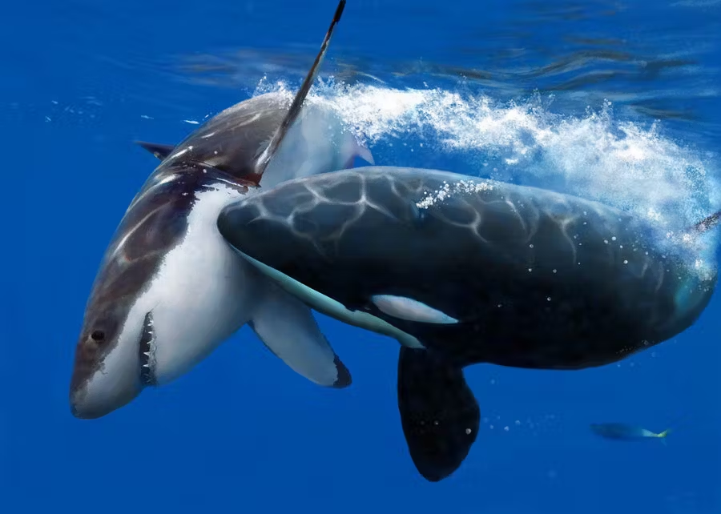
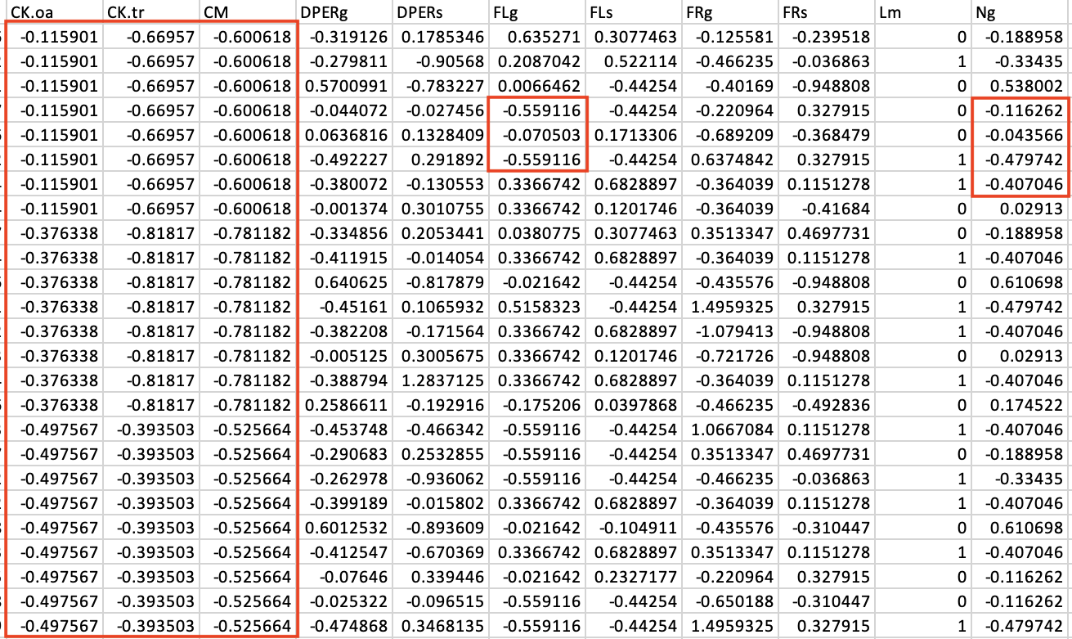
WHERE IT ALL WENT WRONG:
“STANDARDIZATION”- A CASE STUDY
Us
Standardized data
Notes:
Clara:
iNSERT dun dun dunn
\https://www.youtube.com/watch?v=cphNpqKpKc4
The data in the study we used was transformed; which meant we had (-) values for variables like salmon density, or number of orcas in
We tried to contact the authors
Subtracted the mean and divided by 2sd (but they didn’t provide us with these values)
We tried to use the unscale function and we tried to do it manually but it didn’t work
We were not able to un-standardize the data provided by the study. So we were not able to the raw and generate random salmon abundance and lactating female data.

Slide 5

INTRODUCING:
THE POWER ANALYSIS
Notes:
Clara:
Insert Rocky Music: https://www.youtube.com/watch?v=r81AviZECUE
Explain what we aim to do with the power analysis: We are looking to see if we run 1000 trials how many of them, how many models will have a statistically significant effect.
Our randomization of the data aims to mimic real world observations.
We can see whether we have a significant effect or not.

Slide 6

Methods - Poisson, GLMM, Power Estimate
Poisson Distribution
Used with count data
Discrete events within an interval
Mean event occurrences per each interval (lambda)
Betas used to calculate lambda for lactating
Generalized Linear Mixed Model (GLMM)
Includes random and fixed effects
Allows for various distributions of response variable
Looks for a linear relationship between response and fixed effects
Power Estimate

Slide 7
Methods
Salmon abundance ~ commercially caught (1980-2010)
North Pacific Anadromous Fish Commission
Chinook & Chum
Using the max and min abundances for the salmon we generated random distribution through time
Notes:
Data on Salmon quantities was sourced from the North Pacific Anadromous Fish Commission. This data on Chinook and Chum Salmon catch numbers in Canada’s Pacific was used as guidelines to inform data generation of Salmon abundances overtime. We were forced to generate data as the raw data used by Stredulinsky, et al. was not available.
Data on number of female lactating Northern Resident Killer Whales was sourced from NOAA Fisheries which provided the statistic that there a 20% chance of a reproductive age female to give birth in a given year. The data on the proportion of reproductive age females per pod was sourced from ____ and is was stated to be between 20-24% of a pod which we averaged to 22%. We then used this data to generate a power analysis using a binomial distribution using the above statistics.
Each row has a binomial that runs trials for the # of reproductive female and percent likelihood of success (in this case, reproduction)
Poisson distribution to generate the total numbers of the population
Multinomial to determine how many individuals in a pod based on the population overtime

Slide 8
Methods
Number of orcas ~
NOAA Fisheries
As of 2019 -> ~300 orcas in population, ~16 pods
Poisson distribution -> mean total of orcas per year
Multinomial distribution -> generate pods with less than mean total
Lactating Orcas ~
Poisson distribution with ß₁ as effect of pod size, ß₂ as effect of salmon abundance
ß₁: 0.2-0.24 (from COSEWIC)
ß₂: 0.00001-0.1 (various discrete levels, estimation)
Power analysis to determine power estimate (# of significant models)
Notes:
Data on Salmon quantities was sourced from the North Pacific Anadromous Fish Commission. This data on Chinook and Chum Salmon catch numbers in Canada’s Pacific was used as guidelines to inform data generation of Salmon abundances overtime. We were forced to generate data as the raw data used by Stredulinsky, et al. was not available.
Data on number of female lactating Northern Resident Killer Whales was sourced from NOAA Fisheries which provided the statistic that there a 20% chance of a reproductive age female to give birth in a given year. The data on the proportion of reproductive age females per pod was sourced from ____ and is was stated to be between 20-24% of a pod which we averaged to 22%. We then used this data to generate a power analysis using a binomial distribution using the above statistics.
Each row has a binomial that runs trials for the # of reproductive female and percent likelihood of success (in this case, reproduction)
Poisson distribution to generate the total numbers of the population
Multinomial to determine how many individuals in a pod based on the population overtime

Slide 9
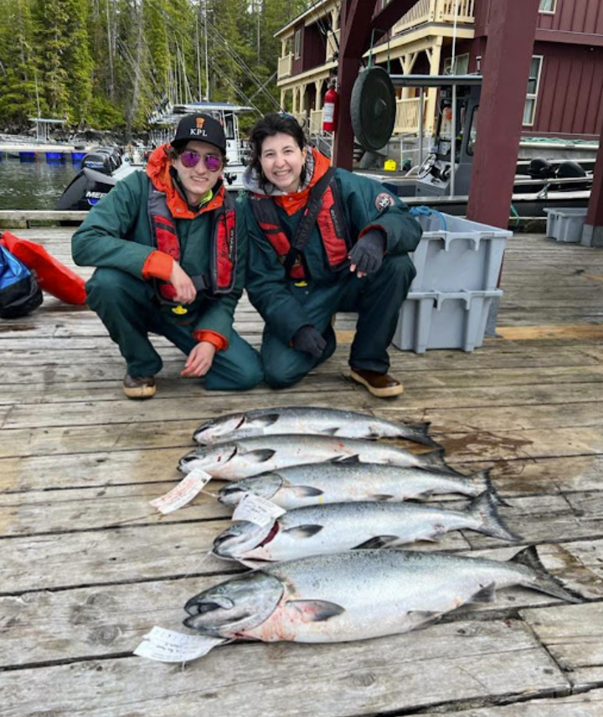
Assumptions
Fish data assumptions:
Changes in fish catch is equal to changes in real pop.
Real fish pop. is likely higher in abundance
Fish abundance is not changing with time (random)
Orca data:
All pod sizes are equally likely
Total number of orcas each year varies according to a poisson distribution
Uniform 20-24% reproductive age females /year
Female orcas won’t give birth while they’re nursing
Notes:
Fish data:
Our data is simulated from commercial catch in the ocean
We’re assuming that the changes in abundance of fish being caught is an accurate representation of how the total fish population is changes over time.
We assumed that the real abundance is larger than what we modeled because not all fish are caught and the catch data isn't accounting for chinook salmon in the river.
Orca data:
For the pods, we’re assuming a pod of any size is equally likely to occur,
This most likely isn't true in real life
Larger pods aren’t as common in nature
We’re assuming that the total number of orcas each year, throughout the 30 years varies according to a poisson distribution. The total number of orcas reflects the birth and death rates.
This orca population is actually endangered, there number are likely to fluctuate largely in the real population
We are likely, though it's not confirmed, that we are accounting for the fact that female orcas won’t give birth until they’re done nursing, which is at least 1 year after the calf is born through the statistic from NOAA fisheries.

Slide 10
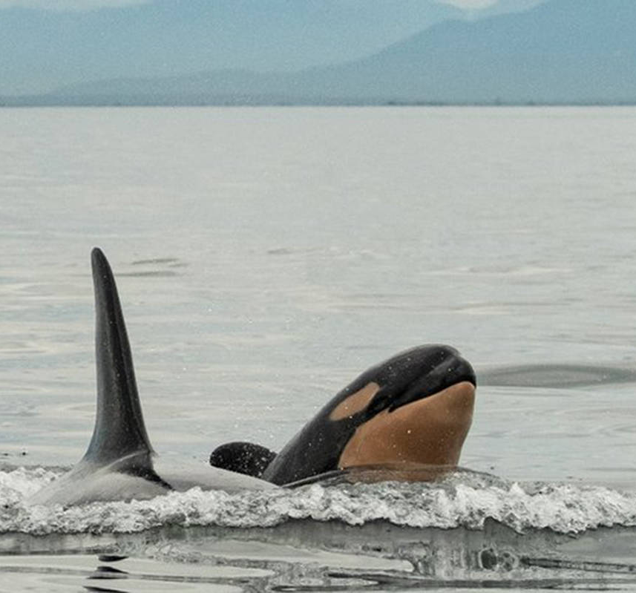
Data Analysis
Data analysis was performed using a power analysis with a General Linear Mixed Model with a poisson distribution
Fixed Variables:
Number of lactating females (dependent),
Pod Size (independent)
Salmon abundance including Chinook and Chum (independent)
Random Variables:
Year which ranges from 1980 to 2010
Group ID which identifies individual pods

Slide 11
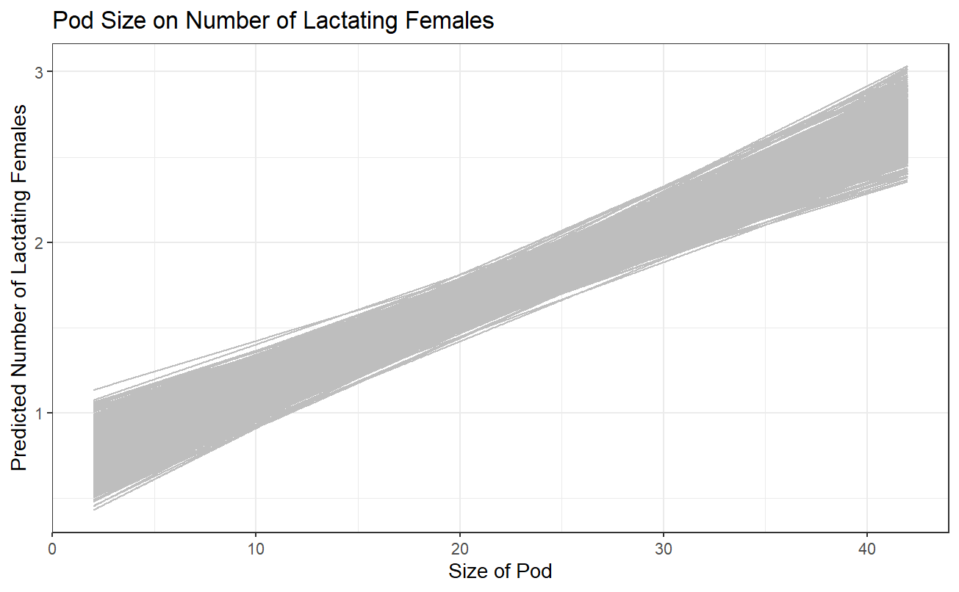
Notes:
Include image of database

Slide 12
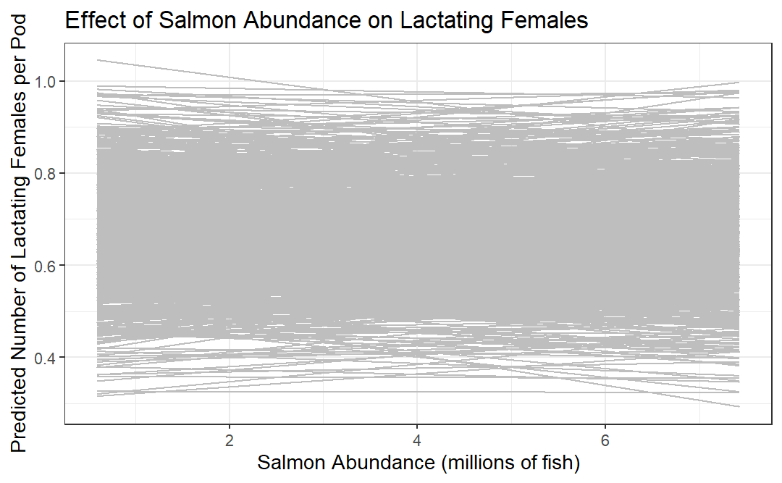

Slide 13

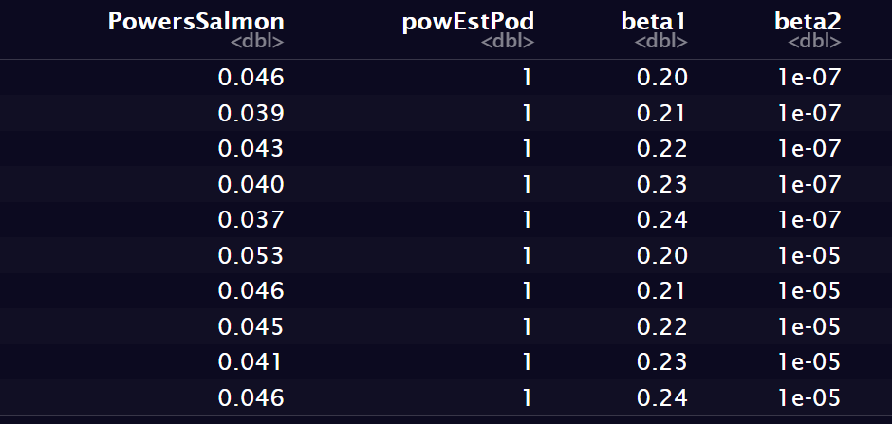
Results
The results are significant for pod size, but the results were not significant for salmon abundance.
for the pod size on lactating females: all 30 GLMMs (which include all combinations of betas) and all 1000 simulations for each GLMM are significant.
For salmon abundance on lactating females: the results were not significant with the power estimates of the 30 GLMM ranging from 28 to 61 out of 1000 simulations being significant.
Notes:
Inset graph
Larger pod size = more lactating females
More fish does not mean more lactating females

Slide 14
Conclusions
We failed to reject our null hypothesis that the Salmon quantities will not influence the number of lactating females in a pod.
Reject our null hypothesis that pod size does not impact the number of lactating females.
Implications unclear:
generated as opposed to true lactating Orca and Salmon abundance data
Confounding variables influence # of lactating females
Assumptions probably not true
For conservation it can be helpful to know that larger pods are associated with greater fecundity
Notes:
Assumptions: salmon quantities much larger than the catch numbers likely and therefore the true data could have had a significant effect
Also reality is populations are likely declining
# of lactating females simulated with a poisson dist and likely not true to reality

Slide 15
Works Cited
Barrett-Lennard, L. G. (2000). Population structure and mating patterns of Killer Whales (Orcinus orca) as revealed by DNA
analysis (T). University of British Columbia. Retrieved October 26, 2023, from
https://open.library.ubc.ca/collections/ubctheses/831/items/1.0099652
CBC/Radio Canada. (2021, February 18). Southern Resident Killer Whale Community welcomes new baby orca | CBC news. CBCnews. https://www.cbc.ca/news/canada/british-columbia/new-baby-orca-born-to-southern-resident-killer-whale-community-1.5917889
Imgur. (n.d.). Killer whale vs great white shark. https://imgur.com/gallery/2U9B8
Secretariat, T. B. of C., & Secretariat, T. B. of C. (n.d.). Northern Resident Killer Whale Group Cohesion (1980-2010)—Open Government Portal. Retrieved September 29, 2023, from https://open.canada.ca/data/en/dataset/8c773994-1031-411b-a1ad-933928daa4ac
Stredulinsky, E.H., Darimont, C.T., Barrett-Lennard, L. et al. Family feud: permanent group splitting in a highly philopatric mammal, the killer whale (Orcinus orca). Behav Ecol Sociobiol 75, 56 (2021). https://doi.org/10.1007/s00265-021-02992-8
Victoria News Staff. (2019). It’s a girl! Baby Orca snapped by Victoria Whale Watching Company. Victoria News. https://www.vicnews.com/community/its-a-girl-baby-orca-photographed-by-victoria-whale-watching-company-57794
Wasser, S. K., Lundin, J. I., Ayres, K., Seely, E., Giles, D., Balcomb, K., Hempelmann, J., Parsons, K., & Booth, R. (2017). Population growth is limited by nutritional impacts on pregnancy success in endangered Southern Resident Killer Whales (Orcinus orca). PLOS ONE, 12(6). https://doi.org/10.1371/journal.pone.0179824
Wegner, H. (2022). Newest Bigg’s killer whale calf spotted off San Juan Islands | fort ... Fort Worth Star-Telegram. https://www.star-telegram.com/news/nation-world/national/article269057147.html
COSEWIC. 2008. COSEWIC assessment and update status report on the Killer Whale Orcinus orca, Southern Resident population, Northern Resident population, West Coast Transient population, Offshore population and Northwest Atlantic / Eastern Arctic population, in Canada. Committee on the Status of Endangered Wildlife in Canada. Ottawa. viii + 65 pp. www.sararegistry.gc.ca/status/status_e.cfm.
NOAA Fisheries. 2019. KILLER WHALE (Orcinus orca): Eastern North Pacific Northern Resident Stock National Oceanic and Atmospheric Association Fisheries. https://media.fisheries.noaa.gov/dam-migration/ak2001whki-penar-508.pdf

Slide 16
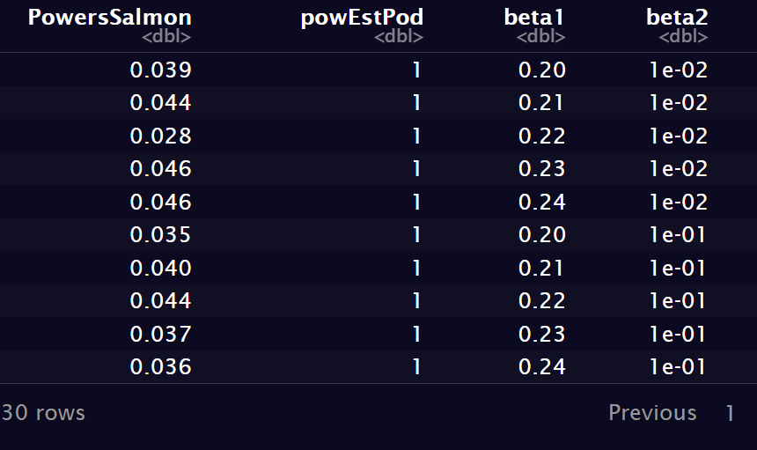
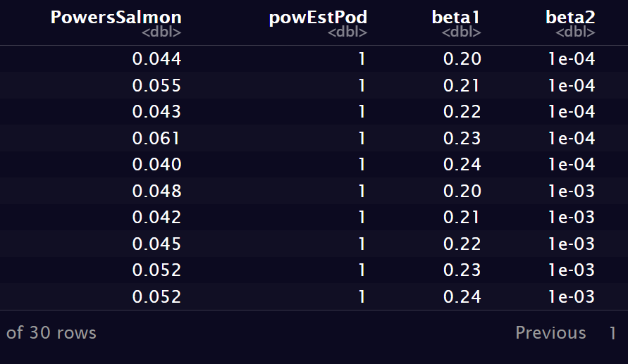
Notes:
Include image of database

